Slide 1
Merlot Client Information System

Slide 2
Role in team
Students:
Reinhardt Eiselen (u14043302) – Code modulation, Landing page, Unit Testing, Integration Testing, API Implenetation
Len Bekker (u11026953) – GitHub organization, API Documentation, Hosting environment, Continuous Integration and API implementation
Kearabiloe Nare (u10068083) – Website Design, Website CRUD, Server CRUD, Server testing and Project board
Mpho Mashaba (u14309999) – Database triggers, Website CRUD, Server testing, Code review and Quality Standards
Ryan Hartley (u15016880) – Database schema, Database testing, Administration, Integration Testing and Quality Standards

Slide 3
Project Management
We have created a project on GitHub which has 4 columns being :
To do - Tasks still needing to be done
In Progress – Tasks currently being handled
In Review – After completion, the task needs to be reviewed before it can be considered done.
Done – Once a person other than the one who worked on a task reviews the work, it will be moved to the “Done” column meaning that the task is complete.

Slide 4
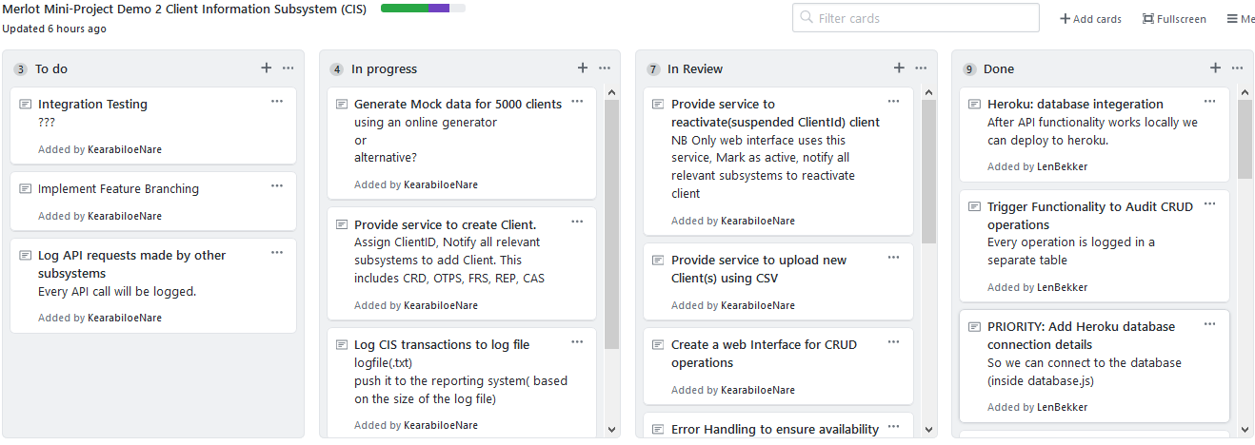
Project Management

Slide 5
GIT Structure
There is a master folder for which the completed, working aspects of the project appear.
There is a staging branch where elements of our sub-system are merged together to test the overall functionality of the sub-system before making its way to the master branch.
Each element was worked on in a separate branch, before being merged into the staging branch.

Slide 6
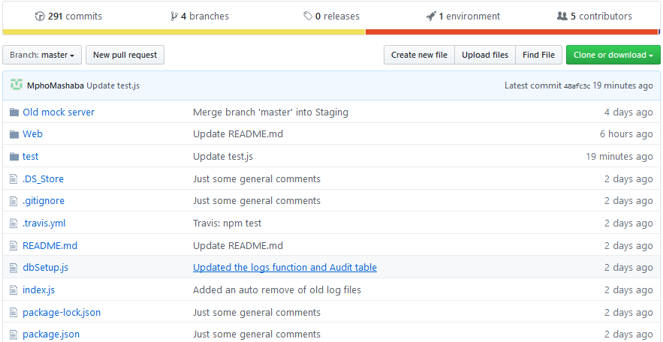
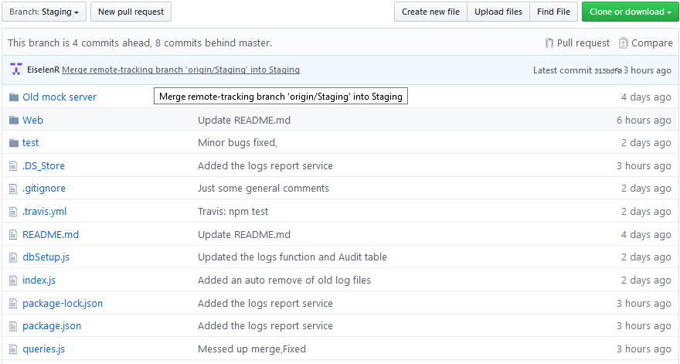
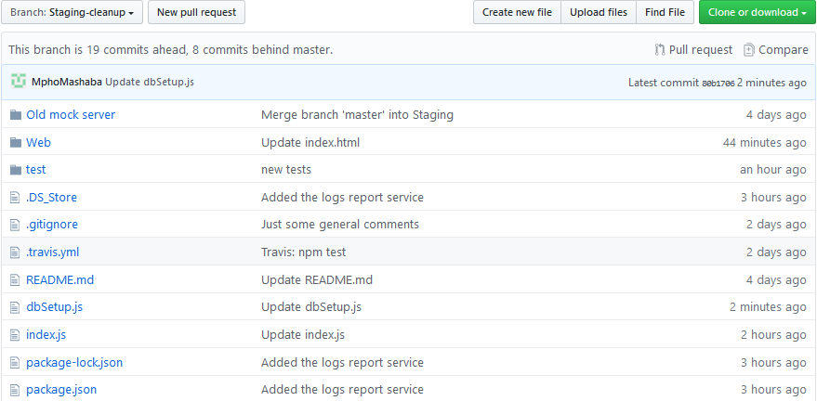
GIT Structure

Slide 7
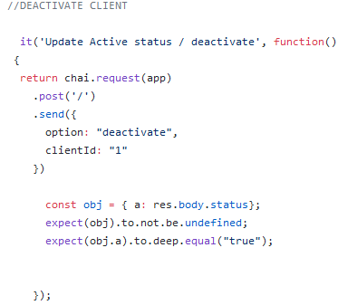
Unit testing
Unit testing was done using Mocha and Chai. Each function was tested individually, making sure that the expected response was given under the pre-determined conditions.
For example:

Slide 8
Integration Testing:
Integration Testing was done on three levels, making use of Mocha, Chai.
Function compliance to the rules of the database.
Integration between the functions within the Client Information sub-system(CIS).
Integration between the CIS, CAS, Facial recognition system and Card(authentication system).

Slide 9
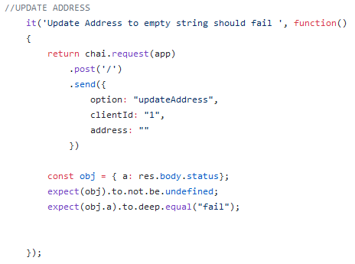
Integration Testing
Database rules:

Slide 10
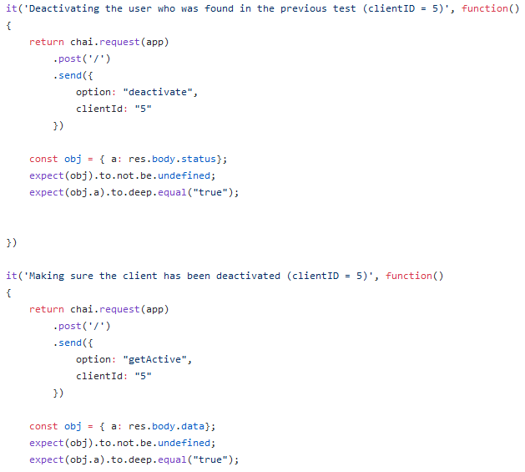
Integration Testing
CIS function integration:

Slide 11
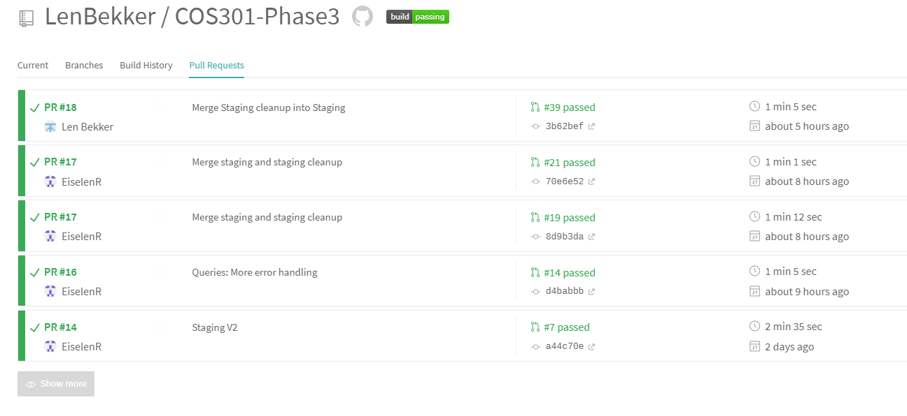
Continuous Integration:
Travis CI: Pull Requests tests

Slide 12
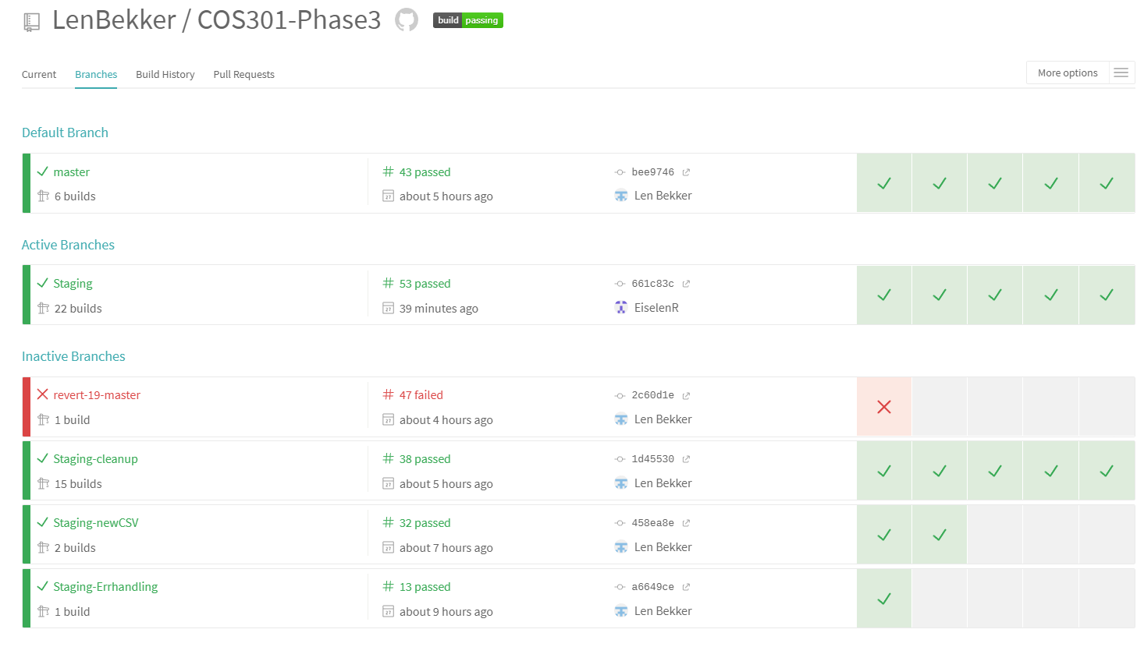
Continuous Integration:
Travis CI: Branch tests

